Slide 1
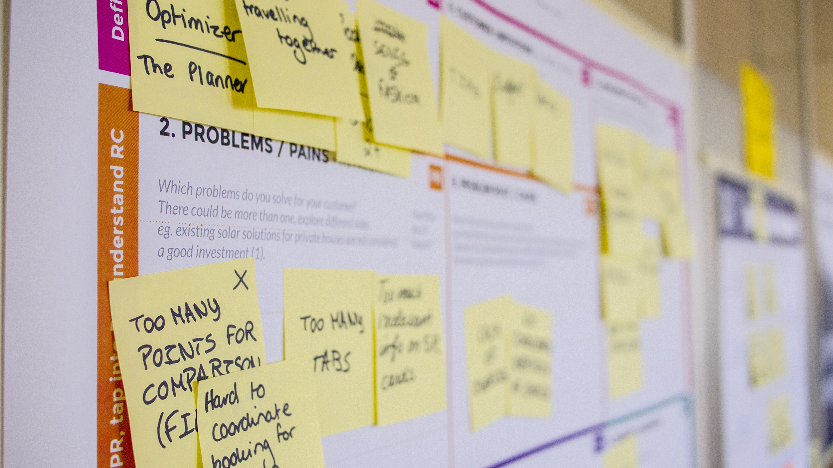
Create your own Empathy Map
Go to Miro.com and sign up for an account
Use the Template Quick Retrospective
Set it up like my miro board
Start populating information for each of your user personas earlier

Slide 2
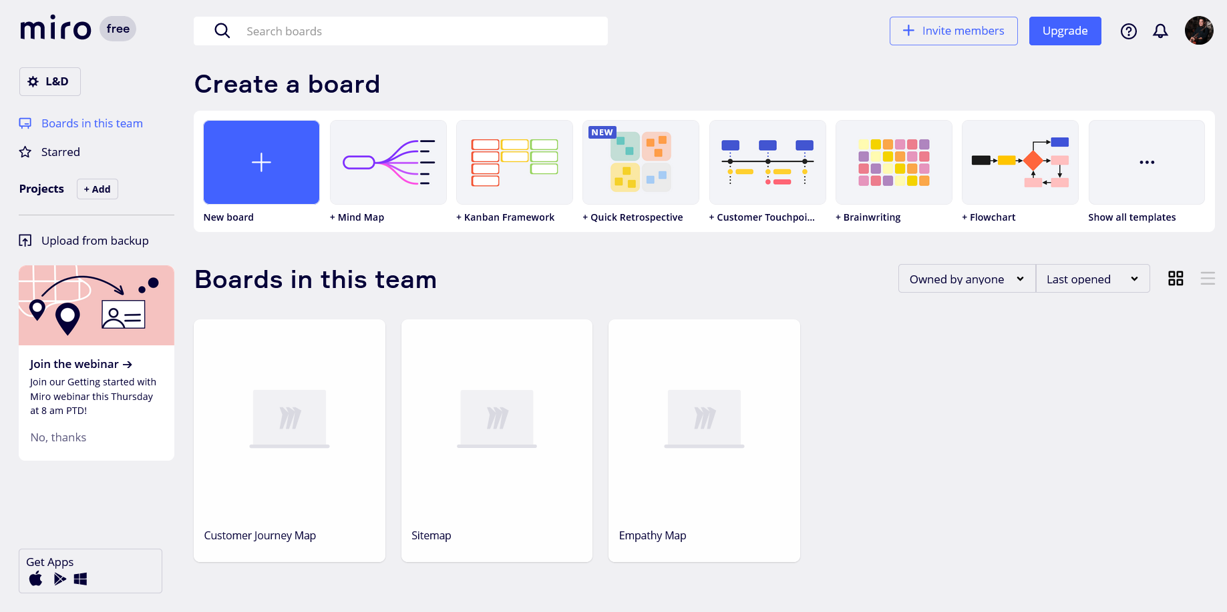
1) Go to Miro.com and sign up for an account

Slide 3
2) From your Dashboard, select Quick Retrospective

Slide 4
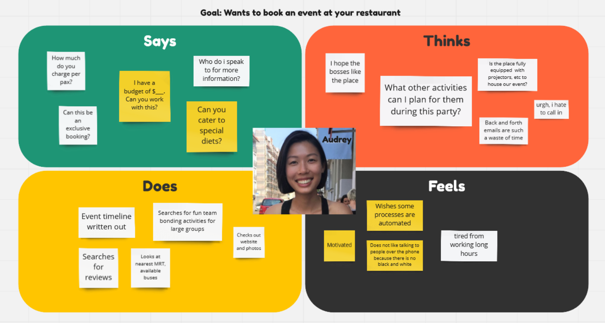
3) Set it up like my Miro board
You will need to rename each of the 4 boxes – Says, Thinks, Does, Feels
Add a picture in the middle of your user persona
Start filling in the each box by adding sticky notes!

